Slide 1
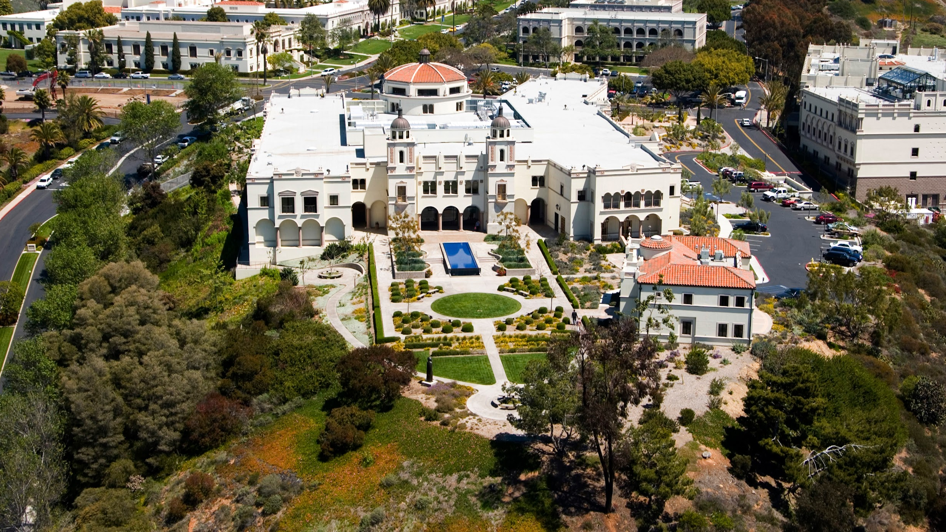
Face Alteration with Generative Adversarial Network
Cole O’ Connell, Eduardo Jimenez, Kevin Mai, Ratul Nandy
University of San Diego

Slide 2

MSAAI 531
Contents
01 Problem Statement
02 GAN in Industry
03 Approach
04 EDA
05 Pre-Processing
06 GAN Architecture
07 Training
08 Results
09 Vector Interpolation

Slide 3
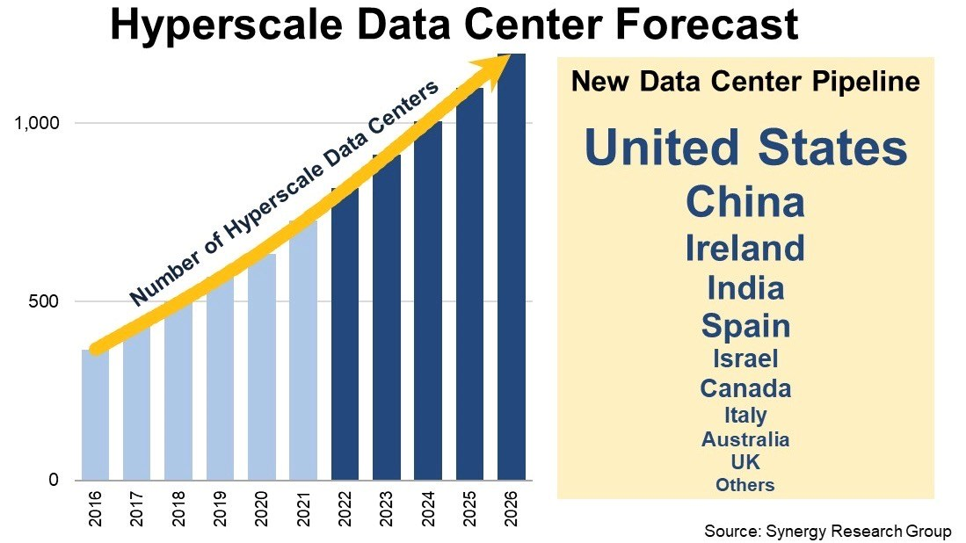
Problem Statement
Figure 1
Data Trend
As society moves more towards a digital world, it has become apparent that computer vision AI models need big image data.
• Online Shopping
• Media Content
• Object recognition
(Maistre 2022)
MSAAI 541
Notes:
Need for clothing models to display product on small businesses websites
Camera filters or mass creation of video game non-player characters
Identifying an emotion such as a neutral face. Generated firtualy from pictures that contain other emotions such as frown

Slide 4
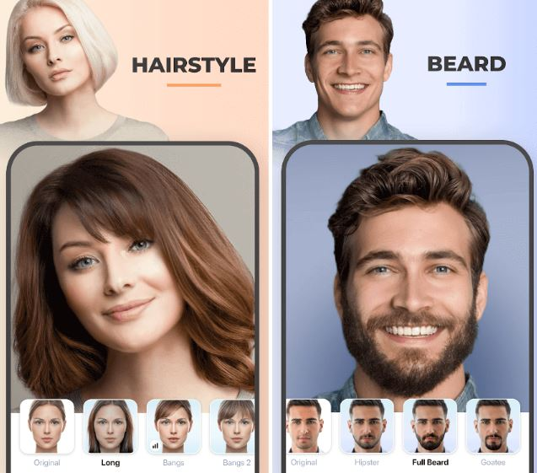
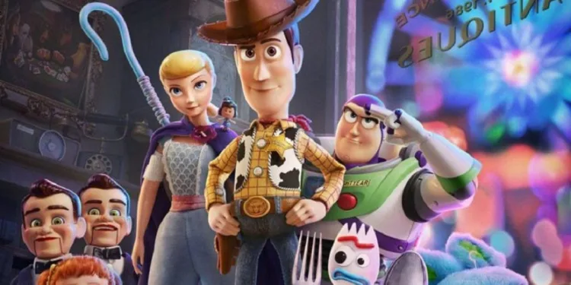
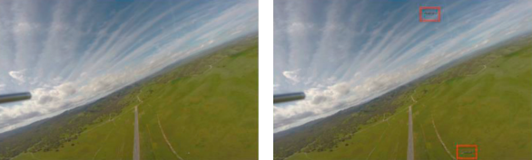
Problem Statement - Real World Examples
(O’Brien, Chris., 2020)
(Broughton Lab, 2020)
(Gupta et. al, 2022, p.10)
MSAAI 541
Notes:
General Transcript:
Here, we have eCommerce or Fashion apps trying to impose hairstyles and beard on faces.
Currently, Pixar is experimenting with models that could reduce up to 50 - 75% of their farm processing footprint (O’Brien, 2020).
Last, a combination of UAV and GAN allows a better object detection system in collaboration with the sensors.

Slide 5
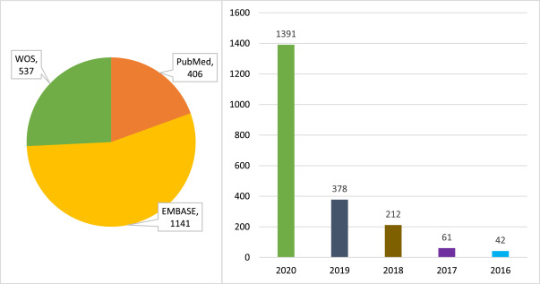
GANs in the Industry
Figure 2
GANs Trend Chart
Generative Adversarial Networks on the rise
Where GANs are successful today
(Aggarwal, A. et. al., 2021)
MSAAI 541
Notes:
Super Resolution
Face frontal view generation
3D virtual avatar creation

Slide 6
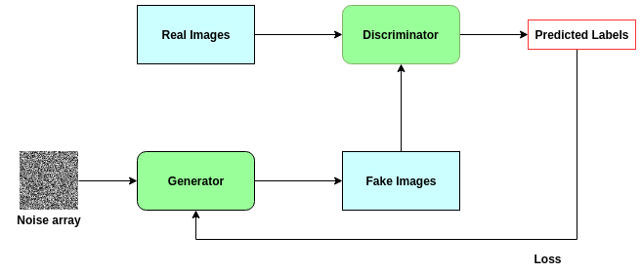
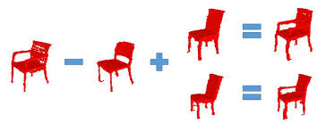
Approach
Generative Adversarial Network in latent space
Figure 3
Figure 4
Typical GAN
Vector Arithmetic in Latent Space
(Rehman, Junaid, 2022)
(Jain, Yasha. 2020).
MSAAI 541

Slide 7
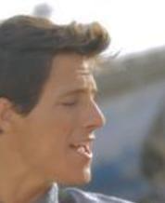
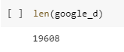
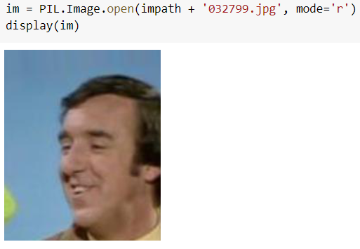
Exploratory Data Analysis
Figure 6
Sample Image Rejected
Celeb_a dataset from TensorFlow
Figure 5
Image Count
Figure 7
Sample Image Used
MSAAI 541
Notes:
More than 200k images in original dataset
Only extracted a partialset due to runtime timeouts
33k were brought in, of the 33k only the 19608 made it through the frontal face filter.
Example shown

Slide 8
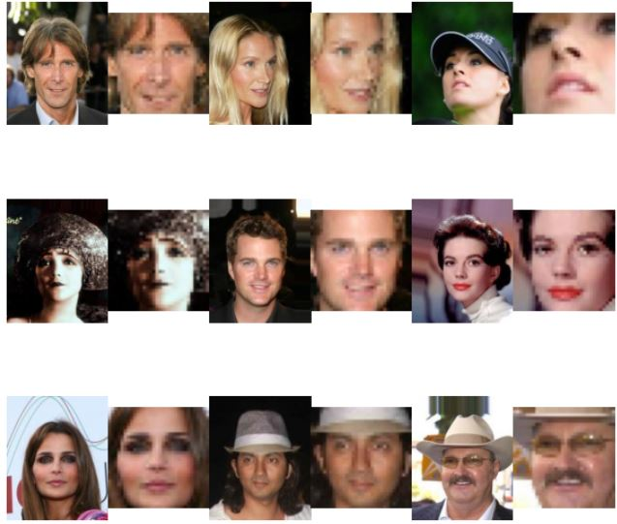
Pre-Processing - Before & After Crops
cv2.CascadeClassifier
Haarcascade Frontal Face
cv2.cvtColor()
cv2.Color_BGR2GRAY
detectMultiScale(gray, 1.3, 5)
Resizing to (32, 32)
MSAAI 541
Notes:
Simple Transcript & Notes:
Haarcascade Frontal Face is cascaded classifier designed for frontal upright faces.
cv2.cvtColor() with BGR2GRAY is a conversion code to turn to grayscale.
Using detectMultiScale() looks at that grayscale image conversion and look for the scaling factor and the nearest neighbors.
Since, we chose 1.3, this is detecting a face up to 30% from the adjusted size scale.
By increasing the minNeighbors, we decrease the amount of false-positive by increasing the strictness.
The Resizing is due to the computational power limitations we had.

Slide 9
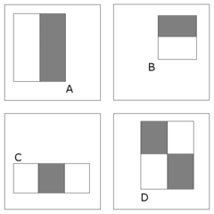
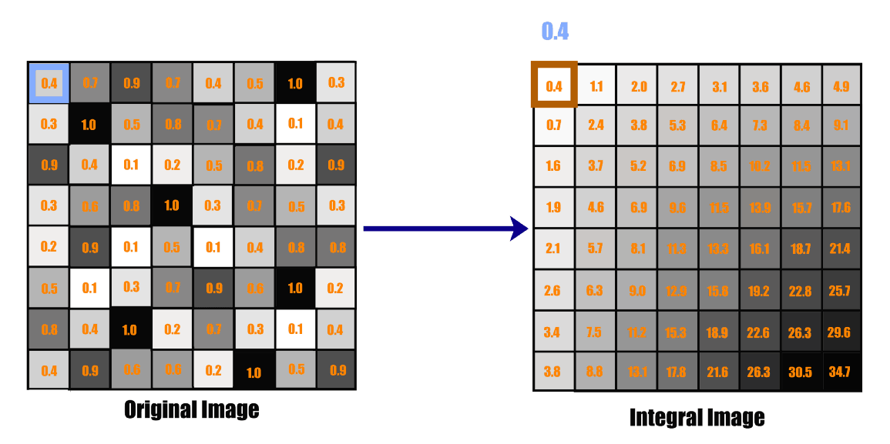
Integral Image Calculation
(Google, 2012)
(Behera, Girija Shankar, 2020))
MSAAI 541
Notes:
To go over this, we can imagine that there are values for gray scales all over the place. On the left, we run a bounding window where we have multiple representations or orientaitons as shown on the top right. Usually a picture will score well on all orientations as each style A, B, C, D is the detection of certain features. Non-face regions will score low, and the window will be discarded faster.

Slide 10
Vanilla Gan to Helper Function / Loss Functions
Generator - generates the image
Discriminator - probability of input belonging
Loss Function - minimizes loss
Optimizer - learning rate
Discriminator Loss:
BinaryCrossEntropy()
tf.ones_like
tf.zeros_like
Generator Loss:
BinaryCrossEntropy()
tf.ones_like
Optimizer
Adam (1.5e^-4, 0.5)
tf.GradientTape()
MSAAI 541
Notes:
First is the generator, second discriminator, loss function, and finally optimizer. - Simplest Gan
tf.ones_like for real loss and tf.zeros like() for fake outputs
tf.GradientTape allows us to track computations and calculate gradients in a stepwise manner with model loss
Adam Optimizer used for faster convergence by controlling the rate of gradients allowing us to find the global minimum value by taking the exponential weighted average
Binary Cross Entropy compares predicted to actual, how close to actual value.

Slide 11
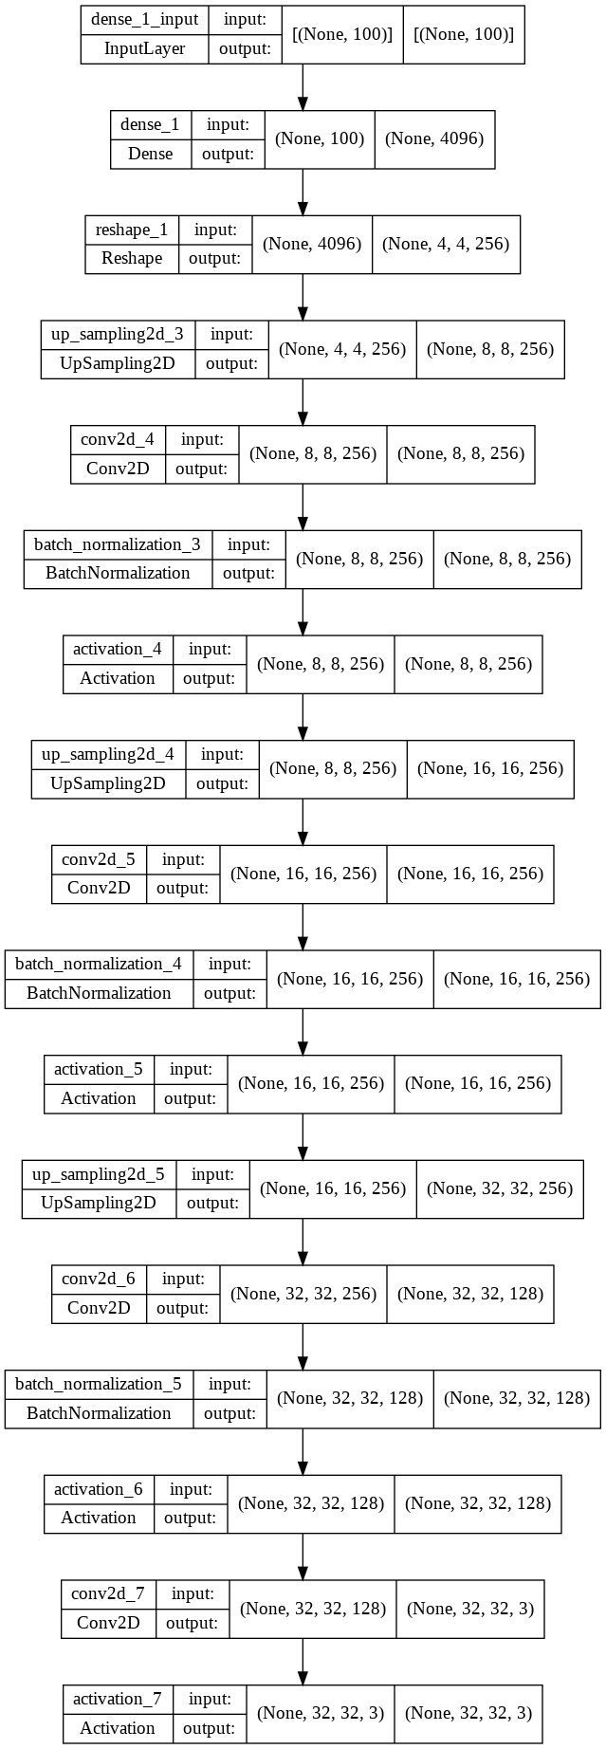
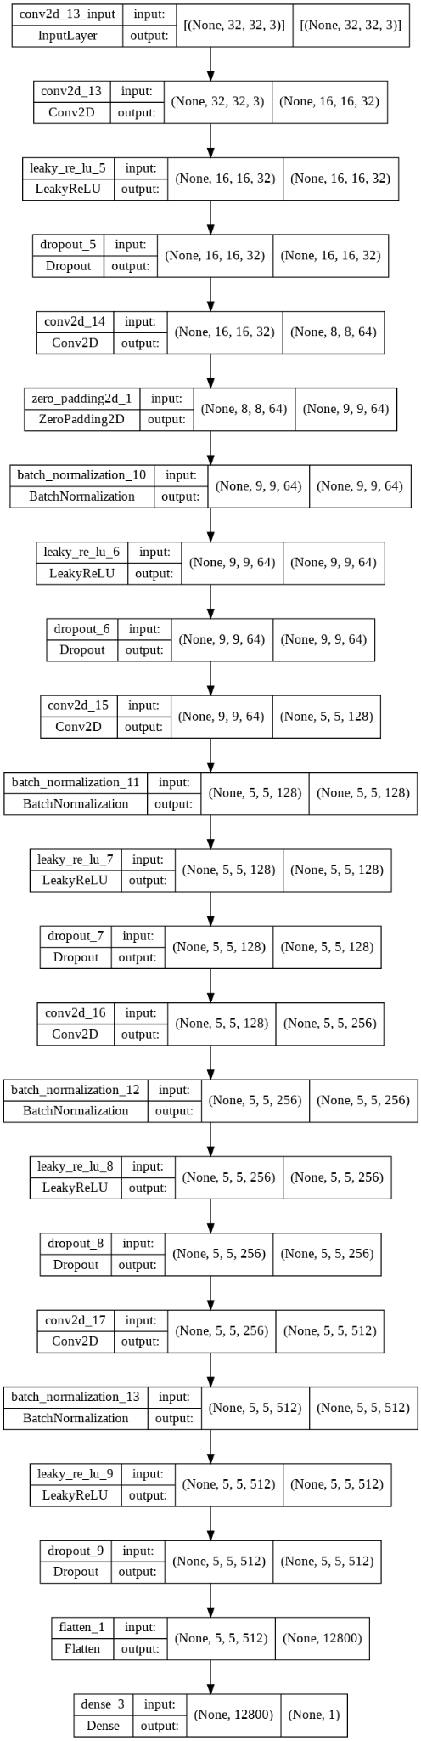
GAN Architecture
Dense Layer
Conv2d
Reshape
Up Sampling
Zero padding
Batch Normalization
Batch Normalization
Generator
Activation
Discriminator
Conv2d
Leaky ReLu
Dropout
Flatten Layer
MSAAI 541
Dense Layer
Notes:
Here is the link to the images: (Under the Generator and Discriminator Cell)
https://colab.research.google.com/drive/1OhatJ0U7xIwjEVVmto6SUvUNt4y7Bwr2?usp=sharing
For our generator, it begins with a dense layer. The dense layer is receive data from all the neurons. Within the dense layers, the activation function, ReLU, is used which filters for positive values. The ReLU function increases speeds and deals with the vanishing gradient problem. The reshape operation which converts the dimension to a 4-dimensional tensor.
We then repeat the structure 3x (UpSample, Conv2D, Batch Normalization and the Activation Function). With the upsample, we are increasing the dimensions.
We end with a tanh function because of its ability to be stringent on negative inputs rather than sigmoid function or a regular ReLU
Looking at the discriminator, the model uses multiple CONV2D layers, the kernel size is 3 or 3x3.
There are multiple “Dropout” layers turning neurons in the preceding layer to zero. With the 0.25 parameter, it eliminates 25% of the neurons through weight reduction. Note the usage of ZeroPadding2D after conv2d in order to add rows and columns.
LeakyReLU is used instead of regular ReLU where it multiplies inputs less than or equal to zero by the specified alpha (0.2). Despite it being fast and tackling the vanishing gradient problem, it is vulnerable to the exploding gradient problem which is when weights and bias increase drastically.
This is why a batch normalization layer is placed behind the LeakyReLU because it normalizes the layers with each batch. Specifically, it scales data mean to zero and standard deviation of one.
Batch Normalization tackles in-covariate shifts which are variations within the model’s middle layers, allowing increases in learning rates (Ioffee and Szegedy, 2015, p.1). Achieving less epochs during training. Finally, flatten layer reshapes into a single dimension for the final dense layer

Slide 12
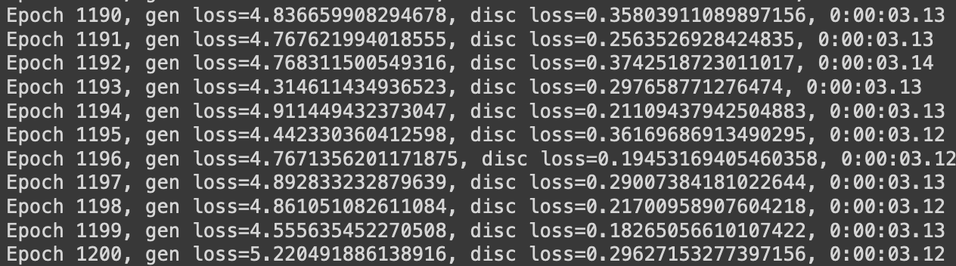
Training GANs
It's a balancing act! If the discriminator gets "too good", then the generator struggles to converge on accurate solutions.
Our best success came from:
Smaller batch sizes and tuning optimizer values
Training the final generator model against multiple discriminators
Time! Early results were quite poor, and it took more than 14 hours to train the final model.
Generator being badly outperformed
MSAAI 541
Notes:
Hi, this is Cole here to discuss the training process for our model. GANs are notoriously difficult to train because of their competitive nature, so it's a balancing act to figure out how best to improve your networks. In this particular task, the discriminator learns rather quickly since it's only job is to identify whether an image belongs to the dataset, which is rather simple compared to the task of the generator. This imbalance prevented many of our early generator models from finding adequate solutions, so we had to tune the hyperparameters to get any decent results. Still, we would run into issues late in training where the generator output would start to deteriorate since it didn't have enough positive reinforcement to learn from. To combat this, we let the generator train with multiple less-skilled discriminators. Even when using the 128 pixel images the training took almost 14 hours, so unfortunately we didn't have the computing resources to train at higher resolutions. Let's take a look at some of the outputs from the generator and compare them to the training data.

Slide 13
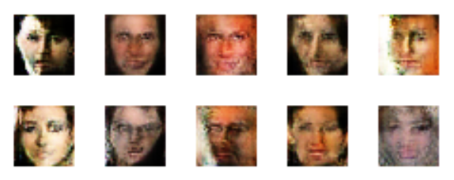
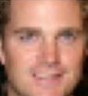

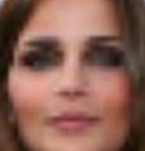
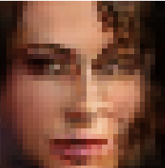
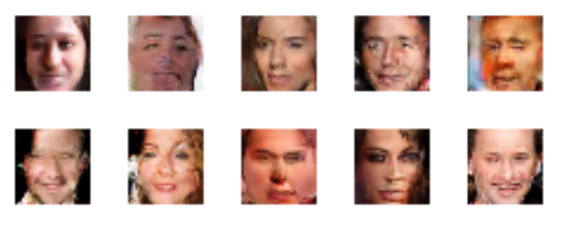
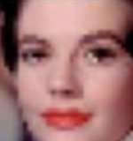
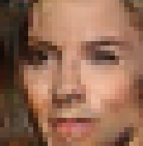
Generator Results
500 epochs
Side by side comparison
Data Examples Generator
~10,000 epochs
MSAAI 541
Notes:
This slide shows some of the progression in the generator model. Even in cases where the image is clearly generated, all the facial features are included and the model simply struggles to assemble them believably. You can see that in early epochs the model struggled with some of the more granular features like the eyes, but in the examples on the right we see the generator correctly adding contours and laugh lines, which is a drastic improvement. When compared with the input data, there are certainly some outputs that would fool me. Once the generator is trained you can do some very interesting things with the vector latent space, which Ratul will talk about next.

Slide 14
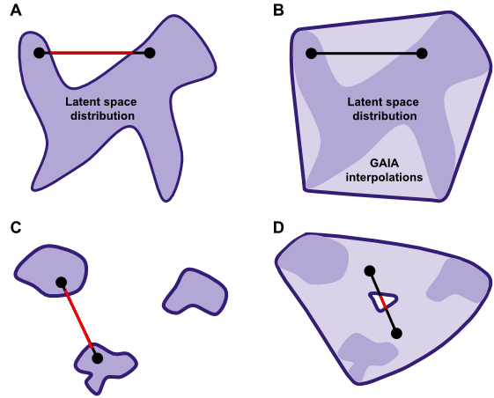



Vector Interpolation Using GAN
While training the GAN, the Generator learns to map certain features of the faces in some distinct area in the latent space. If we generate two random points latent in the space and interpolate ‘n’ linear points between them, we can see a gradual change in some particular features in the image.
MSAAI 541

Slide 15
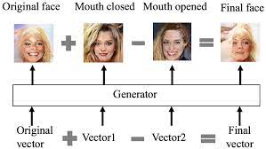
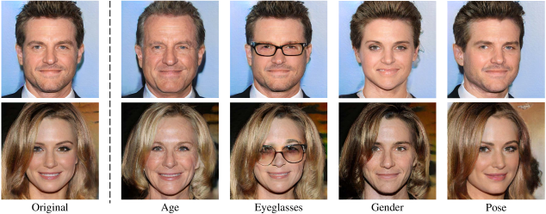
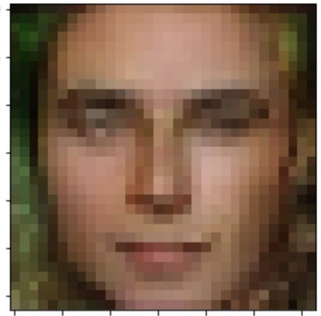
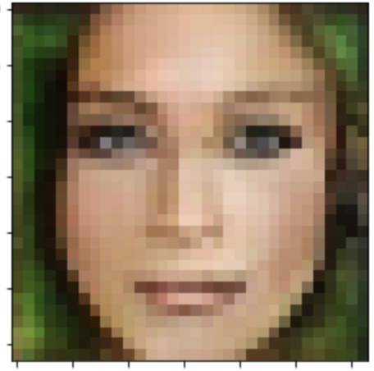
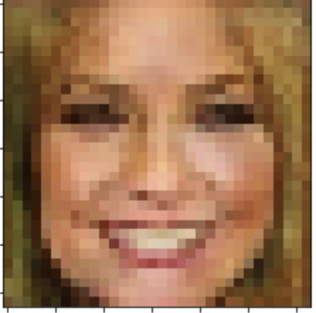
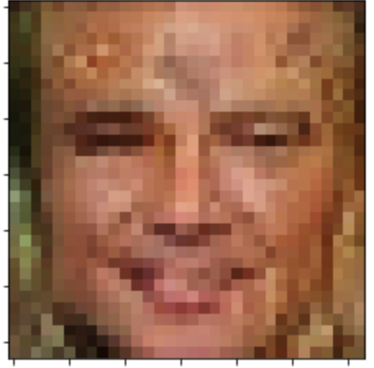
Vector Arithmetic in Latent Space
Neutral Man
Neutral Woman
Smiling Woman
Smiling Man
MSAAI 541

Slide 16
References
Maistre, Ray Le. (2022). How many hyperscale data centres does the world need hundreds more it seems. https://www.telecomtv.com/content/digital-platforms-services/how-many-hyperscale-data-centres-does-the-world-need-hundreds-more-it-seems-44015/
Aggarwal, A., Mittal, M., Battineni, G. (2021). Generative adversarial network: An overview of theory and applications. https://www.sciencedirect.com/science/article/pii/S2667096820300045
Brouton Lab. (2020). Three Cool Applications of GANs in eCommerce. https://broutonlab.com/blog/applications-of-gans-in-ecommerce
O’Brien, Chris. (2020). How Pixar uses AI and GANs to create high-resolution content. https://venturebeat.com/business/how-pixar-uses-ai-and-gans-to-create-high-resolution-content/
Guptha M, N., Guruprasad, Y. K., Teekaraman, Y., Kuppusamy, R., & Thelkar, A. R. (2022). Generative Adversarial Networks for Unmanned Aerial Vehicle Object Detection with Fusion Technology. Journal of Advanced Transportation, 1–13. https://doi-org/10.1155/2022/7111248
Rehman, Junaid. (2022) Advantages and disadvantages of generative adversarial networks. https://www.itrelease.com/2020/06/advantages-and-disadvantages-of-generative-adversarial-networks-gan/
Yasha Jain, Y. (2020). GAN + Latent Space. https://medium.com/@jain.yasha/gan-latent-space-1b32cd34cfda
Viola, P. and Jones, M. (2001). Rapid Object Detection using a Boosted Cascade of Simple Features. https://www.cs.cmu.edu/~efros/courses/LBMV07/Papers/viola-cvpr-01.pdf
Sainburg, T.(2018). Generative Adversarial Interpolative Autoencoding(GAIA) https://timsainburg.com/gaia.html
Li, Z., & Luo, Y. (2017). Generate Identity - Preserving faces by generative adversarial networks.
Shen, Y., Gu, J,. Tang, X., & Zhou, B. (2019). Interpreting the latent space of GANs for semantic face editing
Behera, Girija Shankar. (2020). Face Detection with Haar Cascade. https://towardsdatascience.com/face-detection-with-haar-cascade-727f68dafd08
Google. (2012). Viola-Jones Face Detection. https://sites.google.com/site/5kk73gpu2012/assignment/viola-jones-face-detection#TOC-Image-Pyramid
MSAAI 541

Slide 17
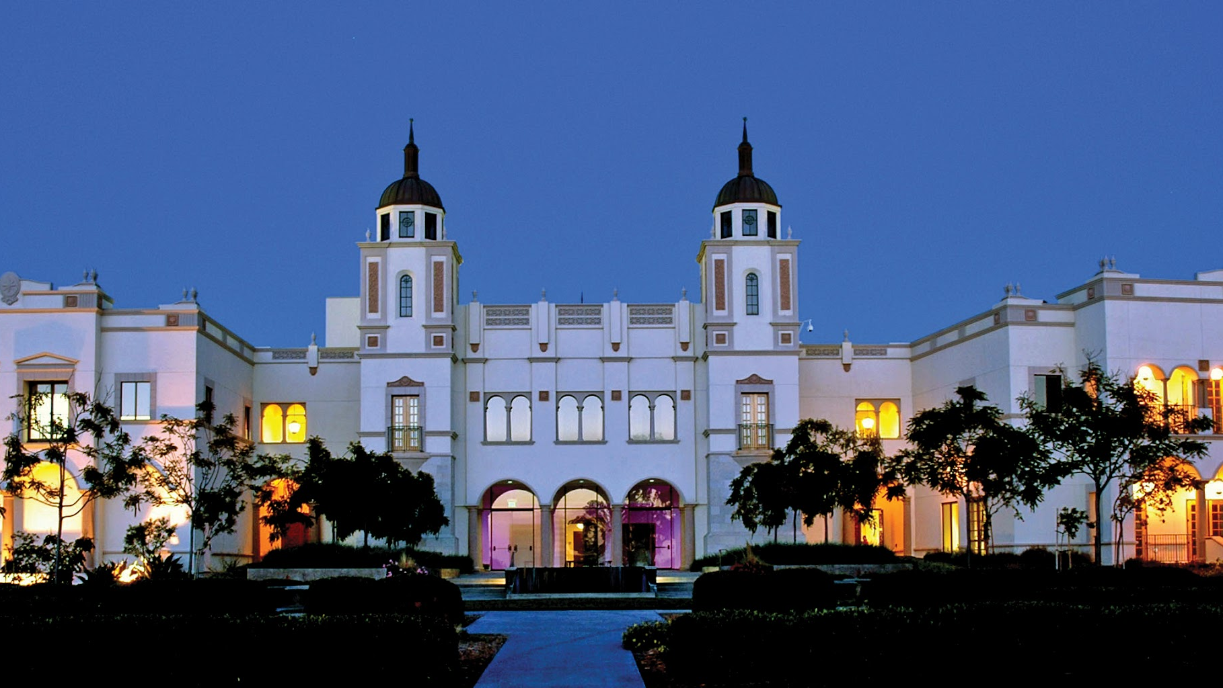
THANK YOU
Board of Advisors

